Slide 1
Getting Started with the Finding API: Finding Items by Keywords
CT4009
Week 10 – Lab Worksheet

Slide 2
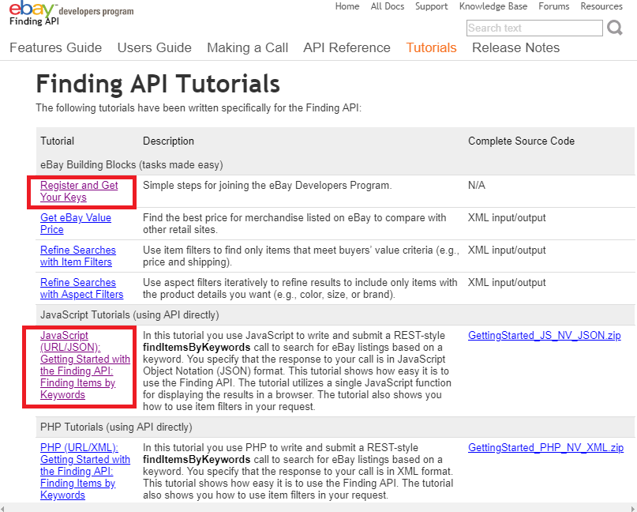
https://developer.ebay.com/DevZone/finding/HowTo/index.html
The above link is an online tutorial that demonstrates how to find items by keywords on eBay using API
First, Register and Get Your Keys
Then try the JavaScript tutorial

